Slide 1
Ag & Biogas Energy
Lesson 7

Slide 2
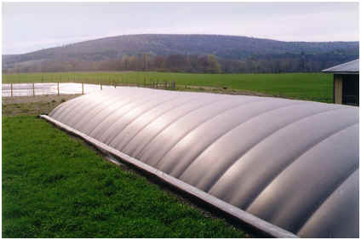
Methane capture on farms
Plug Flow:
Manure must be scraped for collection;
No mixing;
High solids content only

Slide 3
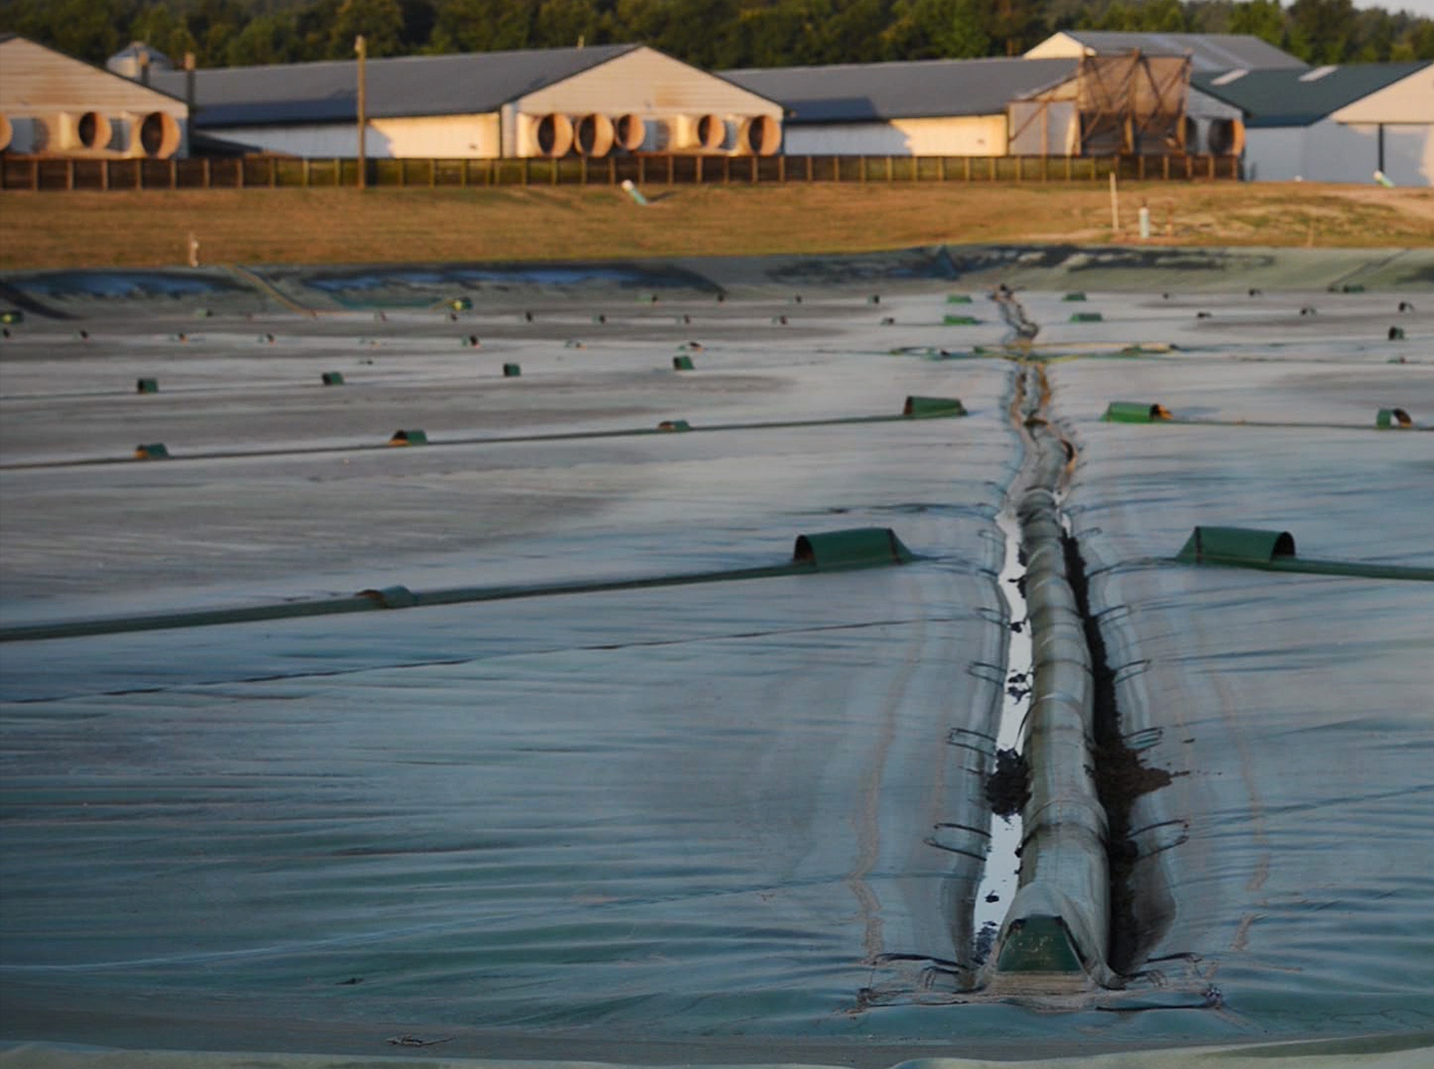
Methane capture on farms
Covered Lagoon
Low maintenance; Unheated;
Liquid manure is topped by a pontoon or other floating cover.
As the manure is digested by bacteria in the lagoon, collected methane is sent to modified natural gas generator or micro turbine to produce electricity.
Designed to use manure with two percent or less solid content.
Requires high throughput for the bacteria to work on enough solids
Methane production is greater in summer than in winter.

Slide 4
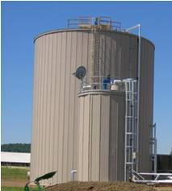
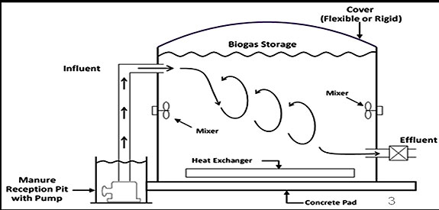
Methane capture on farms
Complete Mix
Heated tank with mixing system;
High moisture content acceptable

Slide 5
Methane capture on farms
Capital costs of an anaerobic digester can be very high and may range from a few hundred thousand to a few million dollars, depending on the size.
Payback periods can range from 5 to 16 years, depending on the conditions of operation.
Value of the biogas from the digester will vary depending on the type of fuel that it is replacing.
In general, an anaerobic digester will not be cost effective for a farm with fewer than 300 head of livestock.
For smaller farms, a cooperative operation used by multiple farms may be an option.

Slide 6
Biological and chemical stages of biogas fermentation processes
Is dependent on the kinds of microorganisms used as well as processing conditions.
Carbohydrates, proteins, lipids, and cellulose are degraded by many kinds of microorganisms.
Converted into organic acids (i.e. butyric acid or propionic acid) by acid producing microorganisms.
Conversion of these organic acids into acetic acids as well as hydrogen.
Methane can be recovered by the methane-producing bacteria.
Since some of the hydrogen produced cannot be converted, the final product of biogas usually contains methane (CH₄) and hydrogen (H₂).
These products can be used in combustion systems or in fuel cell system to generate electricity.

Slide 7
Application on farms
Each year, 81 million tons of manure is created by Iowa’s confined livestock
With methane capture, this could meet the energy needs of 325,000 homes
Anaerobic digesters are site-specific, site studies are needed to assess potential
Methane is one of the most potent greenhouse gases, trapping 25 times as much heat as carbon dioxide
~65% of atmospheric methane is generated from agriculture, with over 1/4 of that coming from livestock
If half of Iowa’s dairy operations had anaerobic digesters, 100 million pounds of methane could be captured each year (
Methane produces more heat per mass unit than other complex hydrocarbons

Slide 8
Economic Benefits
Minimizes time/labor in handling waste
Income from anaerobic digester byproducts & disposal fees
Income from power generation, tax credits & carbon markets energy produced
Reduced on-farm costs for electricity, heat, livestock bedding and water
Increases overall self-sufficiency of farms
At ~$1.13/therm for natural gas, using biogas on-farm can provide a cost-effective replacement.
At ~$1.82/therm for propane, biogas can be a cost-effective replacement with profit potential.

Slide 9
Review
Anaerobic bacteria help biomass decompose in the absence of oxygen.
True
False

Slide 10
Review
Covered lagoon anaerobic digesters produce more methane in the
Winter
Spring
Summer
Fall

Slide 11
Review
Anaerobic digesters are cost effective for small scale farms with fewer than 300 head of livestock.
True
False

Slide 12
Review
Iowa’s livestock produce _______________ tons of manure and could create enough biogas energy to supply 325,000 homes.
51 million
81 million
84 million
104 million

Slide 13
Review
Which of the following are economic benefits of anaerobic digesters?
Reduced on-farm costs for electricity, heat, livestock bedding and water
Minimizes time/labor in handling waste
Increases overall self-sufficiency of farms
All of the above

